Slide 1
CS 457
Python Language Finish
Week 10 Day 2

Slide 2
Agenda
Administration
None
Python Language
Function Arguments

Slide 3
Administration

Slide 4
Python: Language types
√ | Object type | Example literals/creation
√ | Numbers | 1234, 3.1415, 3+4j, 0b111, Decimal(), Fraction()
√ | Strings | 'spam', "Bob's", b'a\x01c', u'sp\xc4m'
√ | Lists | [1, [2, 'three'], 4.5], list(range(10))
√ | Dictionaries | {'food': 'spam', 'taste': 'yum'}, dict(hours=10)
√ | Tuples | (1, 'spam', 4, 'U'), tuple('spam'), namedtuple
√ | Files | open('eggs.txt'), open(r'C:\ham.bin', 'wb')
√ | Sets | set('abc'), {'a', 'b', 'c'}
√ | Other core types | Booleans, types, None
 | Program unit types | Functions, modules, classes

Slide 5
Python Functions
In simple terms, a function is a device that groups a set of statements so they can be run more than once in a program—a packaged procedure invoked by name.
In Python functions behave very differently in Python than they do in compiled languages like C. What follows is a brief introduction to the main concepts behind Python functions

Slide 6
Functions concepts
def creates an object and assigns it to a name and is executable code.
lambda creates an object but returns it as a result
return sends a result object back to the caller
yield sends a result object back to the caller, but remembers where it left off
global declares module-level variables that are to be assigned
nonlocal (3.x) declares enclosing function variables that are to be assigned- Saves state
Arguments are passed by assignment (object reference)
Arguments are passed by position, unless you say otherwise
Arguments are passed by position, unless you say otherwise –operate on any type
Notes:
Define function

Slide 7
Functions Example
The def statement creates a function object and assigns it to a name. Its general format is as follows:
def name(arg1, arg2,... argN):
statements
return value

Slide 8
Functions Assignment
Use the def statement to define a function that converts Celsius to Fahrenheit
hint F = 9/5 * C + 32

Slide 9
Functions Assignment Solution
Use the def statement to define a function that converts Celsius to Fahrenheit
def C2F():
Celsius = int(input("Enter a temperature in Celsius: "))
Fahrenheit = 9.0/5.0 * Celsius + 32
print ("Temperature: " + str(Celsius) + " Celsius = " + str(Fahrenheit), " F")
C2F()
print ("Done")

Slide 10
Functions Assignment Solution
Use the def statement to define a function that converts Celsius to Fahrenheit
def C2F():
Celsius = int(input("Enter a temperature in Celsius: "))
Fahrenheit = 9.0/5.0 * Celsius + 32
print ("Temperature: " + str(Celsius) + " Celsius = " + str(Fahrenheit), " F")
C2F()
print ("Done")

Slide 11
Def is a Statement
def defExample( system, tempIn):
if system=="Metric":
def getTemp(tempIn):
return 9.0/5.0 * tempIn + 32
else:
def getTemp(tempIn):
return 5.0/9.0 * (tempIn - 32)
return (getTemp(tempIn))
localTemp = defExample("Metric", 100)
print("Local Temp = " + str(localTemp))
Def is a statement that executes at runtime.
This is useful for code that needs to be evaluated after it is written, such as localization types of situations.
What if you wanted to write a function that returned the local temperature?

Slide 12
Scope in Python
To effectively write functions in Python, one needs to be aware of how python handles variable scope and namespaces.
The scope of a variable (where it can be used) is always determined by where it is assigned in your source code and has nothing to do with which functions call which. This is known as Lexical Scoping variables may be assigned in three different places, corresponding to three different scopes:
If a variable is assigned inside a def, it is local to that function.
If a variable is assigned in an enclosing def, it is nonlocal to nested functions.
If a variable is assigned outside all defs, it is global to the entire file.

Slide 13
Scope Details
The enclosing module is a global scope. Each module is a global scope—that is, a namespace in which variables created (assigned) at the top level of the module file live. Global variables become attributes of a module object to the outside world after imports but can also be used as simple variables within the module file itself.
The global scope spans a single file only. Don’t be fooled by the word “global” here—names at the top level of a file are global to code within that single file only. There is really no notion of a single, all-encompassing global file-based scope in Python. Instead, names are partitioned into modules, and you must always import a module explicitly if you want to be able to use the names its file defines. When you hear “global” in Python, think “module.”
Assigned names are local unless declared global or nonlocal. By default, all the names assigned inside a function definition are put in the local scope (the namespace associated with the function call). If you need to assign a name that lives at the top level of the module enclosing the function, you can do so by declaring it in a global statement inside the function. If you need to assign a name that lives in an enclosing def, as of Python 3.X you can do so by declaring it in a nonlocal statement.
Notes:
all the code we wrote was at the top level of a module (i.e., not nested in a def), so the names we used either lived in the module itself or were built-ins predefined by Python (e.g., open). Technically, the interactive prompt is a module named __main__ that prints results

Slide 14
Scope Details
All other names are enclosing function locals, globals, or built-ins. Names not assigned a value in the function definition are assumed to be enclosingscope locals, defined in a physically surrounding def statement; globals that live in the enclosing module’s namespace; or built-ins in the predefined built-ins module Python provides.
Each call to a function creates a new local scope. Every time you call a function, you create a new local scope—that is, a namespace in which the names created inside that function will usually live. You can think of each defstatement (and lambda expression) as defining a new local scope, but the local scope actually corresponds to a function call. Because Python allows functions to call themselves to loop—an advanced technique known as recursion
Notes:
all the code we wrote was at the top level of a module (i.e., not nested in a def), so the names we used either lived in the module itself or were built-ins predefined by Python (e.g., open). Technically, the interactive prompt is a module named __main__ that prints results

Slide 15
Scope Summary
Within a def statement:
Name assignments create or change local names by default.
Name references search at most four scopes: local, then enclosing functions (if any), then global, then built-in.
Names declared in global and nonlocal statements map assigned names to enclosing module and function scopes, respectively.

Slide 16
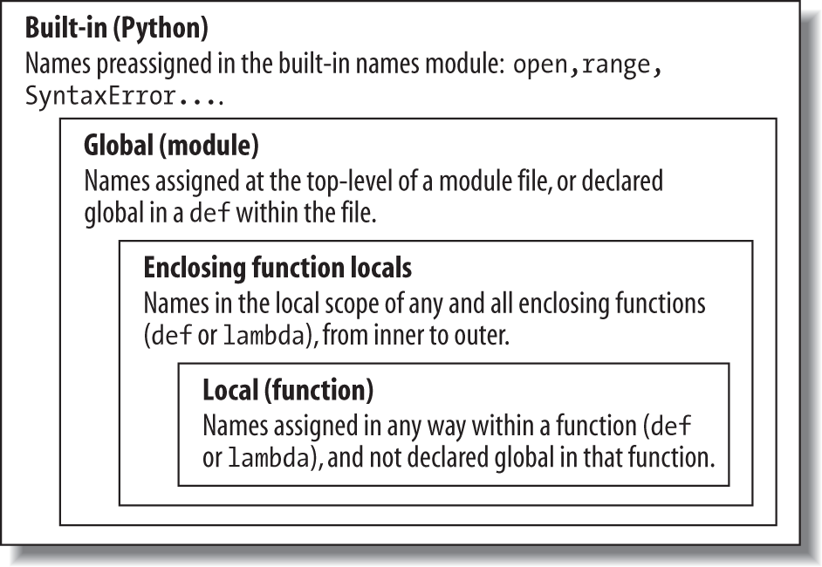
Scope Lookup Rule
L E (N) G B rule for simple (non Object) variables.
E in 2.x and N in 3.x
There are three other scopes:
Temporary loop (Comprehension)
Exception variables
Class local variables

Slide 17
Scope Example
What does this print? Why?
X = 99
def func(Y):
Z = X + Y
return Z
f = func(1)
print ("f = " + str(f))
Notes:
This code prints 100, because X is globally scoped

Slide 18
Global Statement
Global statements are namespace declarations, not type or size declarations.
The global statement tells Python that a function plans to change one or more global names in the enclosing module’s scope (namespace).
Note it is good programming practice to minimize use of Global Statements
Notes:
In other words, global allows us to change names that live outside a def at the top level of a module file. As we’ll see later, the nonlocal statement is almost identical but applies to names in the enclosing def’s local scope, rather than names in the enclosing module.

Slide 19
NonLocal Scope
Nonlocal declares that a name will be changed in an enclosing scope. Unlike global, though, nonlocal applies to a name in an enclosing function’s scope, not the global module scope outside all defs.
Nonlocal scope names must exist prior to using them.

Slide 20
NonLocal Example
What does the following print?
def tester(start):
state = start # Referencing nonlocals works normally
def nested(label):
nonlocal state
print(label, state) # Remembers state in enclosing scope
state += 1
return nested
N = tester(0)
print( N("Ham") )
print( N("Spam") )
Notes:
It printsHam 0
None
Spam 1
None

Slide 21
Function Arguments
We have seen and used arguments to functions earlier. Here ae some key point to keep in mind
Arguments are passed by automatically assigning objects to local variable names. Function arguments—references to (possibly) shared objects sent by the caller—are just another instance of Python assignment at work. Because references are implemented as pointers, all arguments are, in effect, passed by pointer. Objects passed as arguments are never automatically copied.
Assigning to argument names inside a function does not affect the caller. Argument names in the function header become new, local names when the function runs, in the scope of the function. There is no aliasing between function argument names and variable names in the scope of the caller.
Changing a mutable object argument in a function may impact the caller. On the other hand, as arguments are simply assigned to passed-in objects, functions can change passed-in mutable objects in place, and the results may affect the caller. Mutable arguments can be input and output for functions.

Slide 22
Function Arguments
Python is similar to the argument-passing model of the C language (and others) in practice:
Immutable arguments are effectively passed “by value.” Objects such as integers and strings are passed by object reference instead of by copying, but because you can’t change immutable objects in place anyhow, the effect is much like making a copy.
Mutable arguments are effectively passed “by pointer.” Objects such as lists and dictionaries are also passed by object reference, which is similar to the way C passes arrays as pointers—mutable objects can be changed in place in the function, much like C arrays.

Slide 23
Arguments Matching Basics
Python by default, arguments are matched by position, from left to right, and you must pass exactly as many arguments as there are argument names in the function header. However, you can also specify matching by name, provide default values, and use collectors for extra arguments.
But there are some sophisticated tools:

Slide 24
Arguments Matching Tools
Positionals
Keywords:
Defaults:
Varargs collecting:
Varargs unpacking:
Keyword-only arguments

Slide 25
Arguments Positionals
Positionals: matched from left to right
The normal case, which we’ve mostly been using so far, is to match passed argument values to argument names in a function header by position, from left to right.
func(value1, value 2)

Slide 26
Arguments Keywords
Keywords: matched by argument name
Alternatively, callers can specify which argument in the function is to receive a value by using the argument’s name in the call, with the name=value syntax.
def func(spam, eggs, toast=0, ham=0): # First 2 required
print((spam, eggs, toast, ham))
Assignemt What is the output of the following calls?
func(1, 2)
func(1, ham=1, eggs=0)
func(spam=1, eggs=0)
func(toast=1, eggs=2, spam=3)
func(1, 2, 3, 4)
Notes:
Answers:
func(1, 2) # Output: (1, 2, 0, 0)
func(1, ham=1, eggs=0) # Output: (1, 0, 0, 1)
func(spam=1, eggs=0) # Output: (1, 0, 0, 0)
func(toast=1, eggs=2, spam=3) # Output: (3, 2, 1, 0)
func(1, 2, 3, 4) # Output: (1, 2, 3, 4)

Slide 27
Arguments Defaults
Defaults: specify values for optional arguments that aren’t passed
Functions themselves can specify default values for arguments to receive if the call passes too few values, again using the name=value syntax.
def f(a, b=2, c=3):
print(a, b, c)
f(1) # Use defaults 1 2 3
>>> f(a=1) 1 2 3

Slide 28
Arguments Varargs collecting
Varargs collecting: collect arbitrarily many positional or keyword arguments
Functions can use special arguments preceded with one or two * characters to collect an arbitrary number of possibly extra arguments. This feature is often referred to as varargs, after a variable-length argument list tool in the C language; in Python, the arguments are collected in a normal object.

Slide 29
Arguments Varargs collecting
The first use, in the function definition, collects unmatched positional arguments into a tuple:
>>> def f(*args): print(args)
When this function is called, Python collects all the positional arguments into a new tuple and assigns the variable args to that tuple. Because it is a normal tuple object, it can be indexed, stepped through with afor loop, and so on:
>>> f() ()
>>> f(1) (1,)
>>> f(1, 2, 3, 4) (1, 2, 3, 4)

Slide 30
Arguments Varargs collecting
The ** feature is similar, but it only works for keyword arguments—it collects them into a new dictionary, which can then be processed with normal dictionary tools.
In a sense, the ** form allows you to convert from keywords to dictionaries, which you can then step through with keys calls, dictionary iterators, and the like (this is roughly what the dict call does when passed keywords, but it returns the new dictionary):
>>> def f(**args): print(args)
>>> f()
{}
>>> f(a=1, b=2)
{'a': 1, 'b': 2}

Slide 31
Arguments Varargs collecting
Finally, function headers can combine normal arguments, the *, and the ** to implement wildly flexible call signatures.
For instance, in the following, 1 is passed to a by position, 2 and 3 are collected into the pargspositional tuple, and x and y wind up in the kargs keyword dictionary:
>>> def f(a, *pargs, **kargs): print(a, pargs, kargs)
>>> f(1, 2, 3, x=1, y=2)
1 (2, 3) {'y': 2, 'x': 1}
Such code is rare, but shows up in functions that need to support multiple call patterns (for backward compatibility, for instance).

Slide 32
Arguments Varargs unpacking
The * syntax when we call a function, too. In this context, its meaning is the inverse of its meaning in the function definition—it unpacks a collection of arguments, rather than building a collection of arguments. For example, we can pass four arguments to a function in a tuple and let Python unpack them into individual arguments:
>>> def func(a, b, c, d): print(a, b, c, d)
>>> args = (1, 2) >>> args += (3, 4)
>>> func(*args) # Same as func(1, 2, 3, 4)
1 2 3 4

Slide 33
Arguments Varargs unpacking
Similarly, the ** syntax in a function call unpacks a dictionary of key/value pairs into separate keyword arguments:
>>> args = {'a': 1, 'b': 2, 'c': 3}
>>> args['d'] = 4
>>> func(**args) # Same as func(a=1, b=2, c=3, d=4)
1 2 3 4

Slide 34
Arguments Keyword-only arguments
Python 3.X generalizes the ordering rules in function headers to allow us to specify keyword-only arguments—arguments that must be passed by keyword only and will never be filled in by a positional argument. This is useful if we want a function to both process any number of arguments and accept possibly optional configuration options.
Note that keyword-only arguments with defaults are optional, but those without defaults effectively become required keywords for the function

Slide 35
Arguments Keyword-only arguments
For example, in the following, a may be passed by name or position, b collects any extra positional arguments, and c must be passed by keyword only. In 3.X:
def kwonly(a, *b, c):
print(a, b, c)
>>> kwonly(1, 2, c=3)
1 (2,) 3
>>> kwonly(a=1, c=3)
1 () 3
>>> kwonly(1, 2, 3)
TypeError: kwonly() missing 1 required keyword-only argument: 'c'

Slide 36
Arguments Keyword-only arguments
We can also use a * character by itself in the arguments list to indicate that a function does not accept a variable-length argument list but still expects all arguments following the * to be passed as keywords. In the next function, a may be passed by position or name again, but b and c must be keywords, and no extra positionals are allowed:
def kwonly(a, *, b, c):
print(a, b, c)
>>> kwonly(1, c=3, b=2)
1 2 3
>>> kwonly(c=3, b=2, a=1)
1 2 3 >>> kwonly(1, 2, 3)
TypeError: kwonly() takes 1 positional argument but 3 were given
>>> kwonly(1)
TypeError: kwonly() missing 2 required keyword-only arguments: 'b' and 'c'

Slide 37
Arguments Keyword-only arguments
You can still use defaults for keyword-only arguments, even though they appear after the * in the function header. In the following code, a may be passed by name or position, and b and c are optional but must be passed by keyword if used:
def kwonly(a, *, b='spam', c='ham'):
print(a, b, c)
>>> kwonly(1)
1 spam ham
>>> kwonly(1, c=3)
1 spam 3
>>> kwonly(a=1)
1 spam ham
>>> kwonly(c=3, b=2, a=1)
1 2 3
>>> kwonly(1, 2)
TypeError: kwonly() takes 1 positional argument but 2 were given

Slide 38
Arguments Keyword-only arguments
In fact, keyword-only arguments with defaults are optional, but those without defaults effectively become required keywords for the function:
>>> def kwonly(a, *, b, c='spam'):
print(a, b, c)
>>> kwonly(1, b='eggs')
1 eggs spam
>>> kwonly(1, c='eggs')
TypeError: kwonly() missing 1 required keyword-only argument: 'b'
>>> kwonly(1, 2)
TypeError: kwonly() takes 1 positional argument but 2 were given

Slide 39
Arguments Keyword-only arguments
>>> def kwonly(a, *, b=1, c, d=2):
print(a, b, c, d)
>>> kwonly(3, c=4)
3 1 4 2
>>> kwonly(3, c=4, b=5)
3 5 4 2
>>> kwonly(3)
TypeError: kwonly() missing 1 required keyword-only argument: 'c'
>>> kwonly(1, 2, 3)
TypeError: kwonly() takes 1 positional argument but 3 were given

Slide 40
Note About Second Assignment
This weekend I will post the second assignment details
We will implement a book cover graphic editing system for Azteca Books.
Stay tuned.

